Slide 1

DISEASE PREDICTION SYSTEM
DS Project Review-2
 | Under the Guidance of Dr. N.SUNANDA Asst Professor, Department of Computer Science and Engineering, KLH CSE Bowrampet Campus
Team members P. Venkata Sai Charan – 2420030339 M. Sai Shashank – 2420030210 P. Pardhasaradhi - 2420030088

Slide 2
Problem Statement
Many diseases share similar or overlapping symptoms, making early identification difficult.
People may delay seeking medical attention due to a lack of immediate access to healthcare guidance.
Traditional diagnosis requires clinical examination, medical history, and laboratory tests.
There is a need for a data-driven system that can analyze symptoms and provide a preliminary indication of possible diseases.
The proposed system uses Machine Learning algorithms to learn patterns from disease–symptom datasets.
Users can enter their symptoms through a web interface, and the system predicts the most likely condition.
The system also provides the appropriate doctor/specialist category and general health guidance.
The prediction is intended as a decision-support tool and not a replacement for professional medical diagnosis.

Slide 3
Objectives
Develop a Machine Learning-based system for preliminary disease prediction.
Collect and preprocess disease–symptom data for analysis.
Identify symptom patterns using Exploratory Data Analysis (EDA).
Train and compare Decision Tree, Random Forest, KNN, and Naive Bayes models.
Select the best-performing model using Accuracy, Precision, Recall, and F1-score.
Automatically predict the most likely disease from user-selected symptoms.
Recommend an appropriate doctor/specialist based on the predicted condition.
Provide general health guidance and emergency warnings to support users in seeking appropriate medical care.
Develop an interactive web interface using Python and Streamlit.

Slide 4
Literature Survey
Authors | Title of the Paper | Methodology | Inferences | Limitation/Future work
Fatemeh Sogandi et al. [1] | Identifying diseases symptoms and general rules using supervised and unsupervised machine learning | •Supervised ML classification •Unsupervised ML •Association rule mining • Apriori algorithm | • Identifies relationships between symptoms and diseases. • Extracts useful symptom–disease rules. • Can support healthcare professionals and patients. | • Requires validation on broader datasets. • Real-world clinical deployment requires further evaluation.
Rinkal Keniya et al. [2] | Disease Prediction From Various Symptoms Using Machine Learning | • Multiple ML algorithms • Weighted KNN • Uses symptoms, age and gender | • Dataset covers more than 230 diseases. • Weighted KNN achieved 93.5% accuracy. • Demonstrates feasibility of symptom-based prediction. | • Requires larger and more diverse clinical datasets. • Further validation is needed before clinical use.
Deepika Joshi, Renu Kant, Sachin Shakya [3] | Disease Prediction System Using Machine Learning | • Machine Learning algorithms • Symptom-based classification • Medical datasets | • ML can be used to predict diseases from symptoms. • Large healthcare datasets can support better medical decision-making. | • Further improvement in prediction accuracy is required. • More healthcare applications can be explored.

Slide 5
Literature Survey
Authors | Title of the Paper | Methodology | Inferences | Limitation/Future work
N. Ashok et al. [4] | Symptoms Based Disease Prediction System Using Machine Learning | • Decision Tree •KNN •Naive Bayes •Random Forest • Python implementation | • Predicts potential diseases from user symptoms. •Compares multiple ML algorithms. •Supports quick preliminary disease prediction. | • Dataset quality affects prediction accuracy. • Further development is required for real-world healthcare use.
Riya Hedaoo et al. [5] | Disease Symptoms Prediction Application | • Supervised Machine Learning • Symptom-based prediction | • ML can assist in early disease prediction. • Automated symptom analysis can support healthcare decision-making. | • Prediction depends heavily on input symptom quality. • More comprehensive datasets are required.
Ridham Sood, Virat Sharma [6] | Symptom Based Disease Prediction Using Machine Learning | • Decision Tree • KNN • Naive Bayes • Random Forest | • Uses user symptoms as input. • ML models estimate disease likelihood. • Demonstrates the use of ML for healthcare decision support. | • Needs broader validation with real-world patient data. • Model explainability can be improved.

Slide 6
Problem Gap Identification
Existing disease prediction systems mainly focus on basic symptom-to-disease prediction.
Many systems support only a limited number of diseases and symptoms.
Some approaches do not provide clear doctor/specialist recommendations after prediction.
Limited use of multiple ML algorithms and model comparison reduces confidence in model selection.
Many systems lack an interactive and user-friendly web interface for symptom input.
Real-world healthcare data may contain missing values, noise, and inconsistent symptom patterns.
There is a need for a system that combines symptom analysis, ML prediction, model evaluation, and healthcare guidance in one platform.
The proposed system aims to address these gaps as a preliminary decision-support tool, not as a replacement for professional diagnosis.

Slide 7
Innovation, Creativity, and Novelty
AI-Based Prediction: Uses Machine Learning to predict possible diseases from user-reported symptoms.
Multiple ML Models: Compares Decision Tree, Random Forest, KNN, and Naive Bayes to identify a suitable prediction model.
Interactive Symptom Input: Provides a simple web interface where users can select their symptoms.
Doctor Recommendation: Suggests the appropriate medical specialist based on the predicted condition.
Health Guidance: Provides general care information along with the prediction.
Top Predictions: Displays the most probable conditions with confidence/probability scores.
Integrated Platform: Combines symptom analysis, prediction, model comparison, and healthcare guidance in a single application.
Future-Ready Design: Can be extended with real clinical datasets, patient history, laboratory results, and advanced ML models.

Slide 8
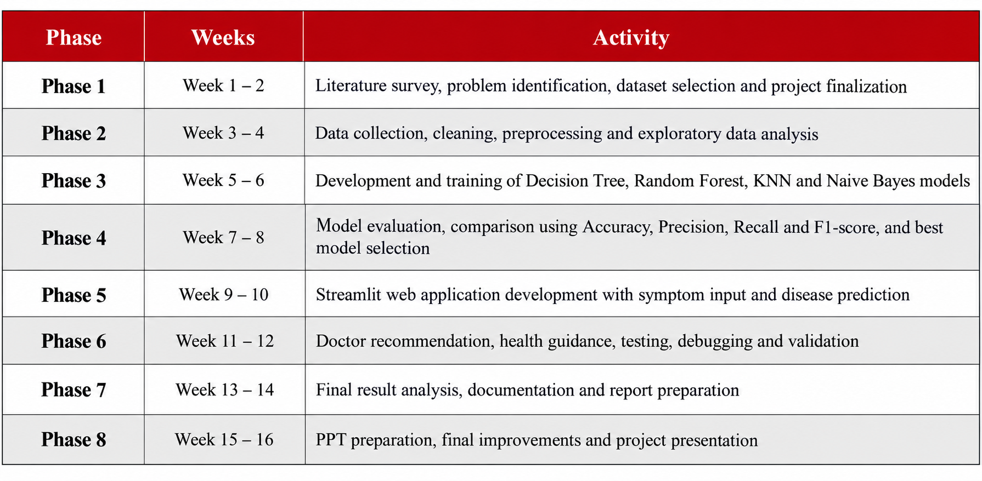
Feasibility and Project Plan
The proposed Disease Prediction System is technically and economically feasible using Python, Pandas, NumPy, Scikit-learn and Streamlit. Open-source machine learning libraries and publicly available symptom-disease datasets reduce development cost and support implementation within the academic project

Slide 9
Thank you

